Slide 1


Javier Vázquez
01/11/2024

Slide 2

Outline
Executive Summary
Introduction
Methodology
Results
Conclusion
Appendix

Slide 3
Executive Summary
Summary of methodologies
- Data collection
- Data wrangling
- EDA with data visualization
- EDA with SQL
- Intecartive map building with Folium
- Dashboard building with Plotly Dash
- Predictive analysis with classification
Summary of all results
EDA result
- Intereactive analytics
- Predictive analiytics

Slide 4
Introduction
Project background and context
The commercial space age has arrived, making space travel more accessible. Companies like Virgin Galactic, Rocket Lab, and Blue Origin are pioneering various aspects of space travel and satellite services. Among these, SpaceX stands out with significant achievements such as sending spacecraft to the International Space Station, launching the Starlink satellite internet constellation, and conducting manned space missions. A key factor in SpaceX's success is the relatively low cost of its Falcon 9 rocket launches, priced at $62 million compared to other providers' $165 million. This cost efficiency is largely due to SpaceX's ability to reuse the first stage of its rockets.
Problems you want to find answers
Space Y, a new rocket company and aims to compete with SpaceX. However, Space Y faces a significant challenge: determining the cost of each rocket launch. Unlike SpaceX, which has mastered the art of reusing the first stage of its rockets, Space Y needs to predict whether the first stage of their rockets will land successfully. This prediction is crucial because it directly impacts the overall cost of the launch. So the aim of presentation to predict the succesfull missions to save costs, demages.

Slide 5

Section 1

Slide 6
Methodology
Executive Summary
Data collection methodology:
SpaceX Open source Rest API
Perform data wrangling
Transforming categorical data using One Hot Encoding for machine learning algorithms and removing any empty or unecessary information from data set
Perform exploratory data analysis (EDA) using visualization and SQL
Perform interactive visual analytics using Folium and Plotly Dash
Perform predictive analysis using classification models
Logistic regression, K-nearest neighbors, Support Vector Machine and Decesion Tree

Slide 7
Data Collection
• 1. Request to the SpaceX API
Collected data from SpaceX’s open API
Retrived and processed the data with GET request
Ensure that only Falcon9 lanunches will be download
Filled missing payload values with avarage values
2. Web Scrapping
Requested past Falcon9 and Falcon Heavy launch data from Wikipedia link.
Accessed to the Falcon9 launch pages via a direct Wikipedia link.
Extracted all the column names from the HTML table
Parsed and transformed the table into a Pandas data frame suitable for analysis.

Slide 8
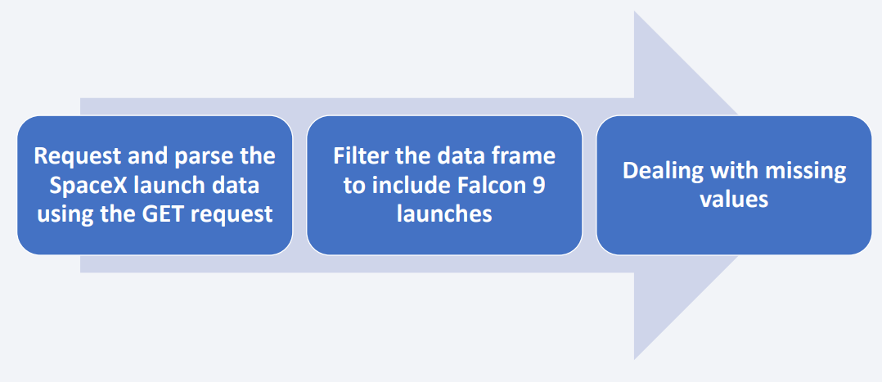
Data Collection – SpaceX API
Used SpaceX API for primary data collection. ○ Helper Functions: Defined functions to extract relevant launch data using unique identifiers. ○ Data Request: Performed GET requests to SpaceX API URL for rocket launch data. ○ Data Processing: Parsed JSON results, then decoded and filtered to include only Falcon 9 launches, converting data into a Pandas DataFrame.
Web Scraping - Falcon 9 Launch Records (Wikipedia) ○ Access Wikipedia Page ○ Extract HTML Table ○ Parse and Convert data to structured format ○ Export Data

Slide 9
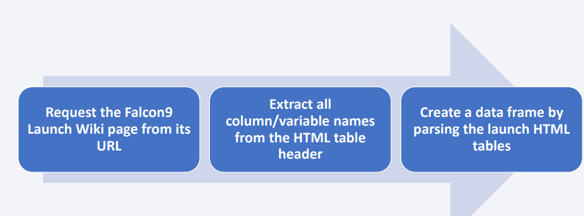
Data Collection - Scraping
Present your web scraping process using key phrases and flowcharts
Add the GitHub URL of the completed web scraping notebook, as an external reference and peer-review purpose

Slide 10
Data Wrangling
Pattern Analysis ○ Performed Exploratory Data Analysis (EDA) to identify patterns and assess landing success rates for label assignment in model training. ● Define Landing Outcomes ○ Examined various mission outcomes: ■ True Ocean: Successful landing in the ocean. ■ False Ocean: Attempted landing but unsuccessful in the ocean. ● Label Creation ○ Converted mission outcomes into training labels: ■ 1 for successful landings. ■ 0 for unsuccessful landings. ● Export Labeled Data

Slide 11
EDA with Data Visualization
Bar chart
• To compare the success rate of each orbit
• Scatter plot chart
• Identify the correlation between:
Line chart
• Visualize the launch success yearly trend

Slide 12
EDA with SQL
1. %sql select distinct(LAUNCH_SITE) from SPACEXTBL;
2. %sql select * from SPACEXTBL where LAUNCH_SITE like 'CCA%' limit 5;
3. %sql select sum(PAYLOAD_MASS__KG_) as payloadmass from SPACEXTBL;
4. %sql select avg(PAYLOAD_MASS__KG_) as payloadmass from SPACEXTBL;
5. %sql select min(DATE) from SPACEXTBL;
6. %sql select BOOSTER_VERSION from SPACEXTBL where LANDING_OUTCOME='Success (drone ship)' and
7. %sql select count(MISSION_OUTCOME) as missionoutcomes from SPACEXTBL GROUP BY MISSION_OUTCOME;
8. %sql select BOOSTER_VERSION as boosterversion from SPACEXTBL where PAYLOAD_MASS__KG_=(select max(PAYLOAD_MASS__KG_) from SPACEXTBL);
9. %sql SELECT substr(Date, 6, 2) as month, MISSION_OUTCOME, BOOSTER_VERSION, LAUNCH_SITE FROM SPACEXTBL WHERE [Landing_Outcome] = 'Failure (drone ship)' AND substr(Date, 1, 4) = '2015’;
10. %sql SELECT LANDING_OUTCOME FROM SPACEXTBL WHERE DATE BETWEEN '2010-06-04' AND '2017- 03-20' ORDER BY DATE DESC;

Slide 13
Build an Interactive Map with Folium
• folium.Circle
- to add a highlighted circle area with a text label on a specific coordinate
• folium.Marker
- to marker_cluster
• folium.Popup
is used to display additional information when a user clicks on a marker on a map
• folium.Map
- It allows you to set the initial location, zoom level, and other map settings.

Slide 14
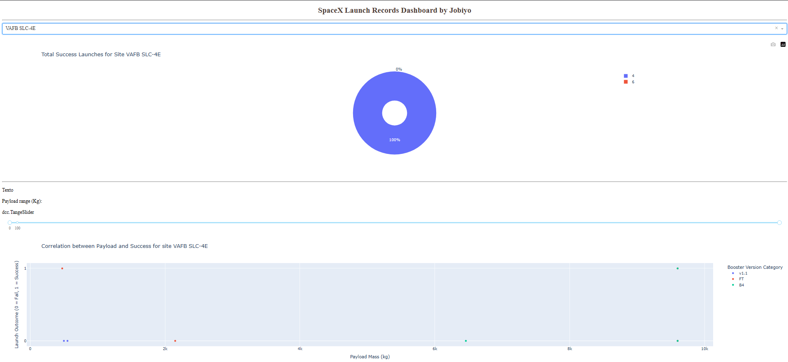
Build a Dashboard with Plotly Dash

Slide 15
Predictive Analysis (Classification)
• Perform exploratory Data Analysis and determine Training Labels • create a column for the class • Standardize the data • Split into training data and test data • Find best Hyperparameter for SVM, Classification Trees and Logistic Regression • Find the method performs best using test data

Slide 16
Results
Exploratory data analysis results
Launch success has improved • KSC LC-39A has the highest success rate among landing sites • Orbits ES-L1, GEO, HEO, and SSO have a 100% cusses rate
Interactive analytics demo in screenshots
Launch sites are fare engough to make demage
Predictive analysis results
Decision Tree model is the best predictive model for the dataset

Slide 17

Section 2

Slide 18
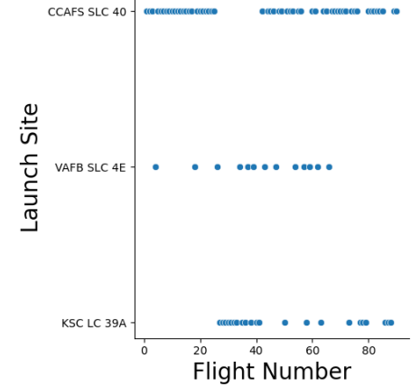
Flight Number vs. Launch Site

Slide 19
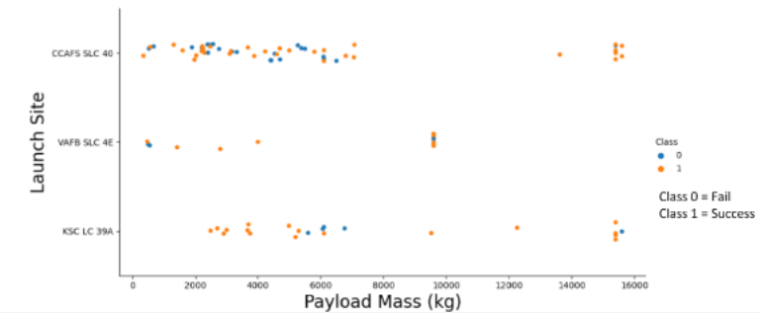
Payload vs. Launch Site

Slide 20
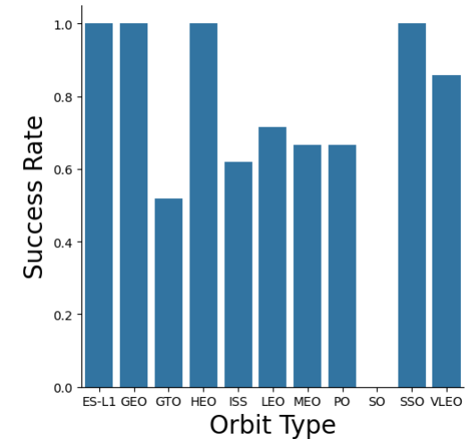
Success Rate vs. Orbit Type

Slide 21
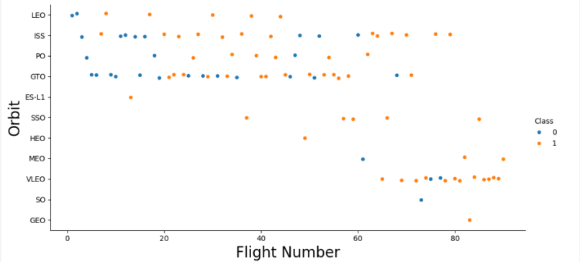
Flight Number vs. Orbit Type

Slide 22
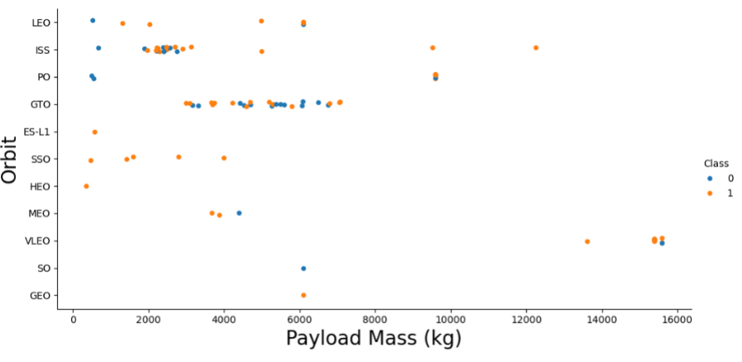
Payload vs. Orbit Type

Slide 23
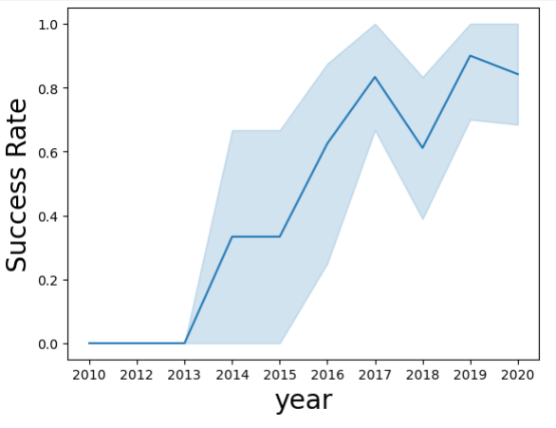
Launch Success Yearly Trend

Slide 24
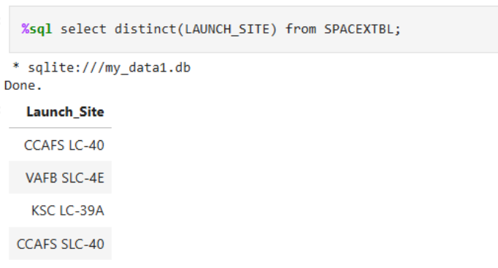
All Launch Site Names

Slide 25
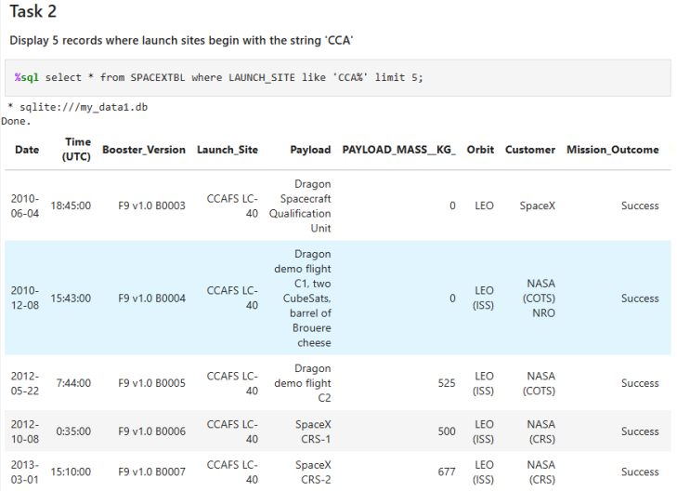
Launch Site Names Begin with 'CCA'

Slide 26
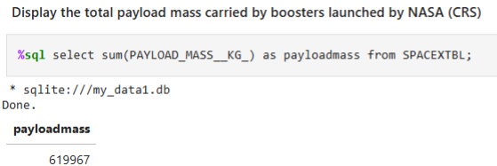
Total Payload Mass

Slide 27
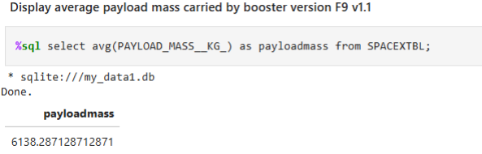
Average Payload Mass by F9 v1.1

Slide 28
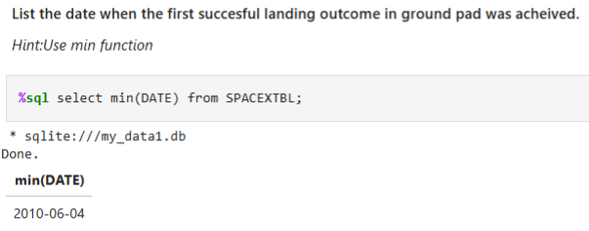
First Successful Ground Landing Date

Slide 29
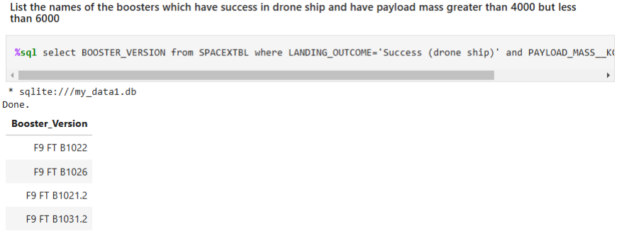
Successful Drone Ship Landing with Payload between 4000 and 6000

Slide 30
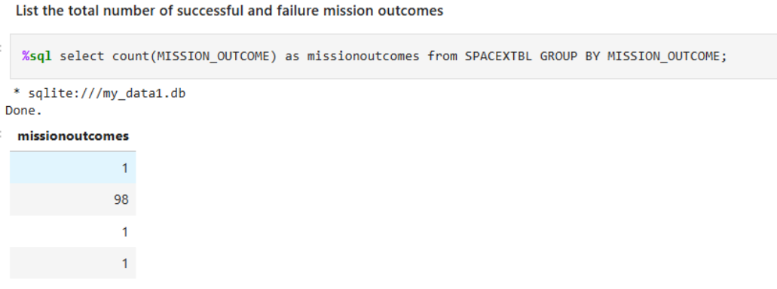
Total Number of Successful and Failure Mission Outcomes

Slide 31
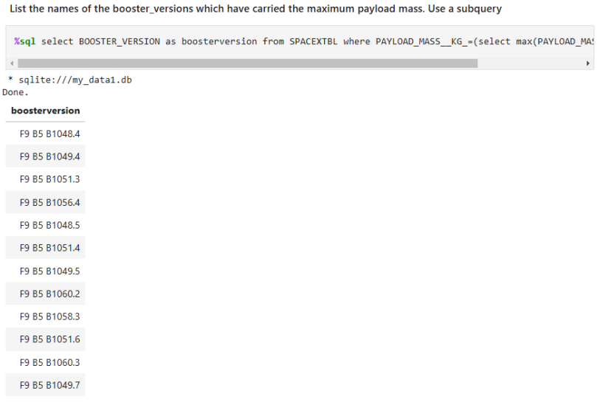
Boosters Carried Maximum Payload

Slide 32
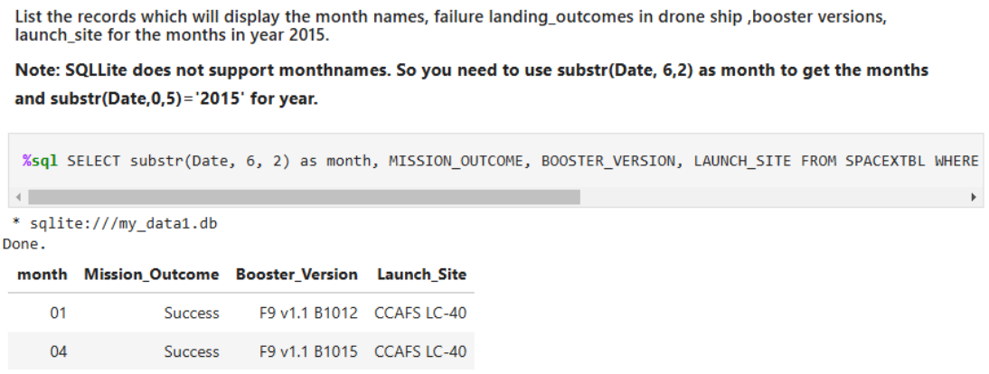
2015 Launch Records

Slide 33
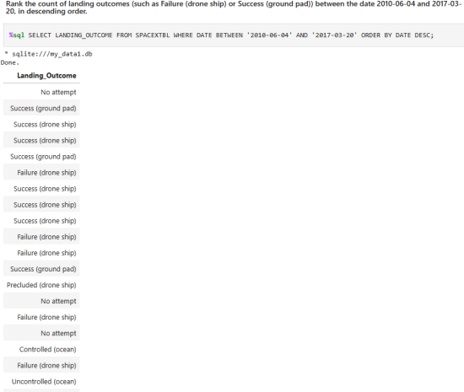
Rank Landing Outcomes Between 2010-06-04 and 2017-03-20

Slide 34

Section 3

Slide 35
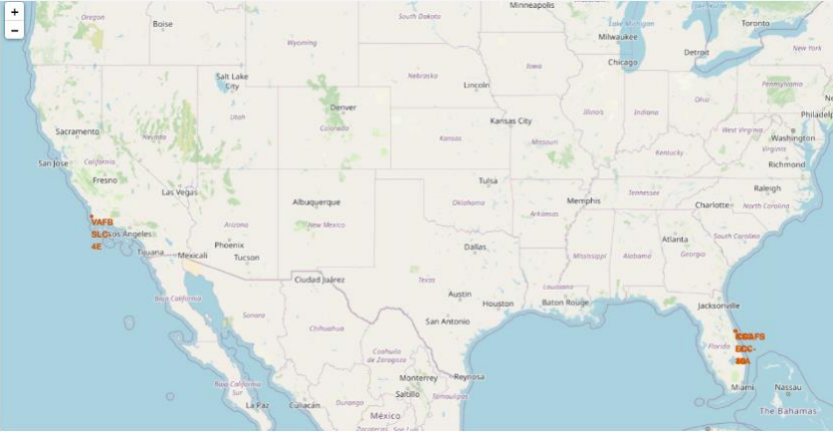
Launch site map

Slide 36
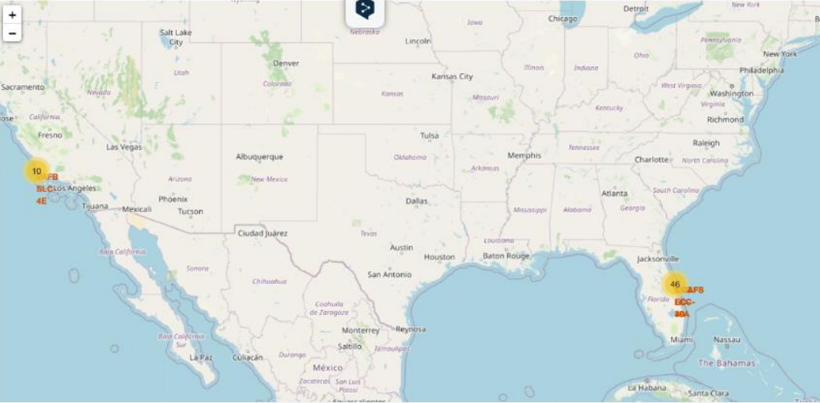
Launch site map

Slide 37
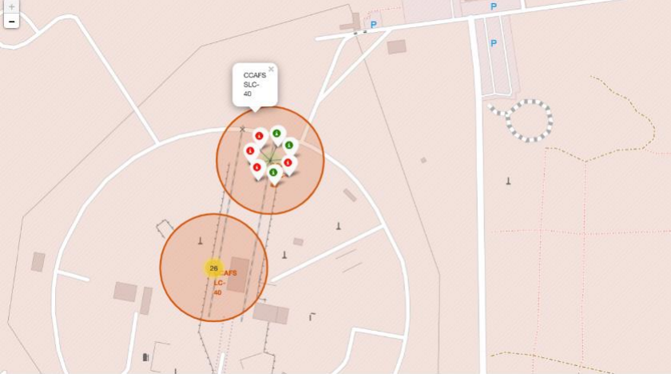
Launch site map with markers

Slide 38

Section 4

Slide 39
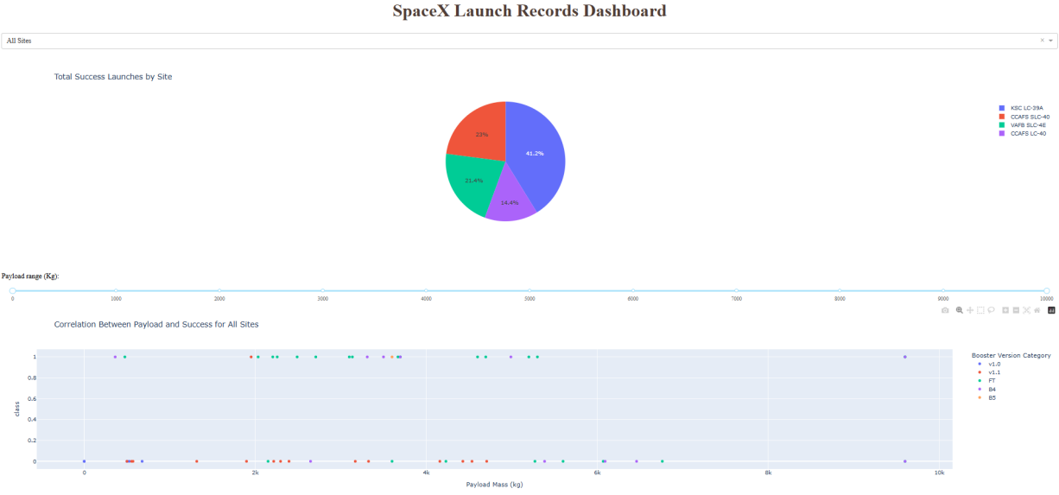
<Dashboard Screenshot 1>

Slide 40
<Dashboard Screenshot 2>

Slide 41
<Dashboard Screenshot 3>

Slide 42

Section 5

Slide 43
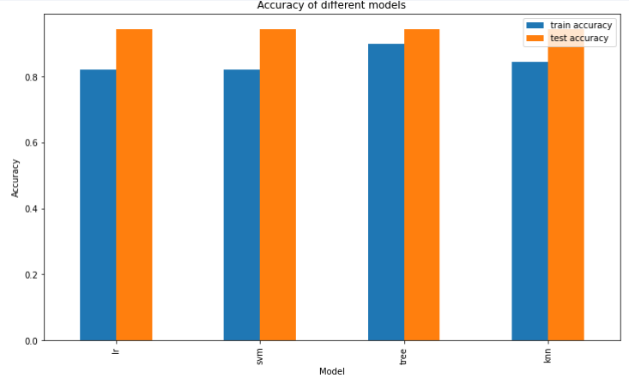
Classification Accuracy

Slide 44
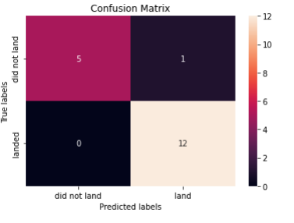
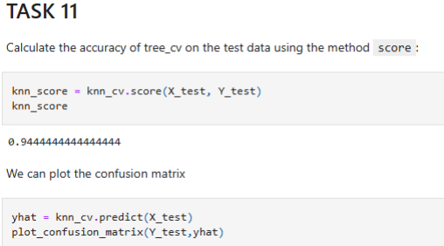
Confusion Matrix

Slide 45
Conclusions
- LR, SVM, KNN are top-performing models for forecasting outcomes in this data
Lighter paylods have a higher performance
Launch sites are fare engough to make demage

Slide 46
Appendix
• Python code snippets
• SQL queries, charts
• Notebook outputs

Slide 47


